Slide 1

CSE 464 : Software Quality Assurance and Testing
Effectiveness of EP and BVA
Janaka Balasooriya

Slide 2
Effectiveness of EP and Boundary Value Analysis – Triangle Problem
Testing Technique | Total Branches Covered
Weak Normal/ Strong Normal (4 Test cases) | 18/28
Strong Normal + Weak Robust (14 Test cases) | 24/28
Strong Normal + Weak Robust + Boundary Values (Normal) 27 Test cases | 28/28
  (Junit test cases for this discussion posted with lecture notes)
  Do we have a better technique?

Slide 3
Limitations of Boundary Value Analysis and Equivalent Partitioning
Both equivalent partition and boundary value analysis test case generation focus on the input domain, output domain, runtime environment …etc while designing test cases.
Its quite likely that most of the logic paths of a complex program may not be executed and meaningful user interactions can easily be overlooked in this
Sometimes it is more effective if test cases are generated by combining inputs and outputs in more meaningful way in the context of the application being tested.
This technique is called the decision tables

Slide 4
Decision Table
• Originally known as Cause and Effect Graphing
  – Done with a graphical technique that expressed AND-OR-NOT logic.
  – Causes and Effects were graphed like circuit components
  – Inputs to a circuit “caused” outputs (effects)
• Equivalent to forming a decision table in which:
  – inputs are conditions
  – outputs are actions
• Test every (possible) rule in the decision table.
• Recommended for logically complex situations.

Slide 5
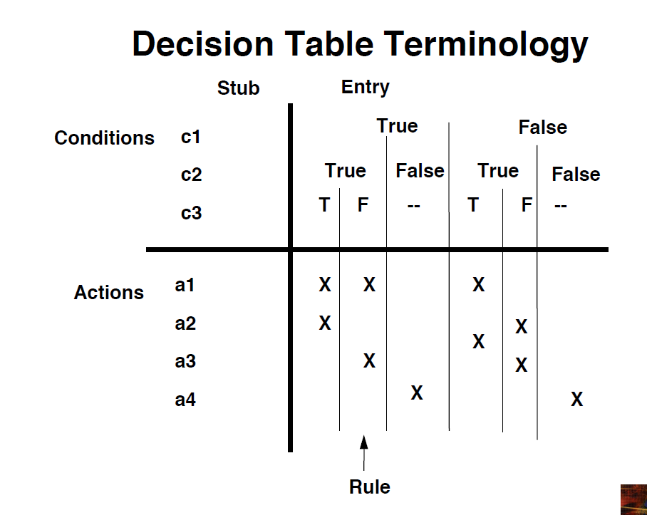

Slide 6
Decision Table for the Triangle Problem – Will be discussed in the class

Slide 7
Triangle Problem
In this situation, a good way to start is to think backwards and generate equivalent classes based on output first. First consider valid data ranges for a, b, and c
Four possible outcomes and relationship among data inputs
Equilateral
E1 = {<a, b, c> : the triangle with sides a, b, and c where a=b=c}
Isosceles
E2 = {<a, b, c> : the triangle with sides a, b, and c where a=b, a≠c | b=c, b≠a | a=c , a≠b}
Scalene
E3 = {<a, b, c> : the triangle with sides a, b, and c where a≠b≠c }
Not A Triangle
E4 = {<a, b, c> : the triangle with sides a, b, and c where a + b <= c | a + c <= b | b + c <= a }

Slide 8
Decision Table – Triangle Problem
c1: a<b+c? | F | T | T | T | T | T | T | T | T | T | T
c2: b<a+c? | — | F | T | T | T | T | T | T | T | T | T
c3: c<a+b? | — | — | F | T | T | T | T | T | T | T | T
c4: a = b? | — | — | — | T | T | T | T | F | F | F | F
c5: a = c? | — | — | — | T | T | F | F | T | T | F | F
c6: b = c? | — | — | — | T | F | T | F | T | F | T | F
a1: Not a triangle | x | x | x
a2: Scalene |  |  |  |  |  |  |  |  |  |  | x
a3: Isosceles |  |  |  |  |  |  | x |  | x | x
a4: Equilateral |  |  |  | x
a5: Impossible |  |  |  |  | x | x |  | x

Slide 9
Corresponding Test Cases
Case ID | a | b | c | Expected Output
DT1 | 4 | 1 | 2 | Not a Triangle
DT2 | 1 | 4 | 2 | Not a Triangle
DT3 | 1 | 2 | 4 | Not a Triangle
DT4 | 5 | 5 | 5 | Equilateral
DT5 | ? | ? | ? | Impossible
DT6 | ? | ? | ? | Impossible
DT7 | 2 | 2 | 3 | Isosceles
DT8 | ? | ? | ? | Impossible
DT9 | 2 | 3 | 2 | Isosceles
DT10 | 3 | 2 | 2 | Isosceles
DT11 | 3 | 4 | 5 | Scalene

Slide 10
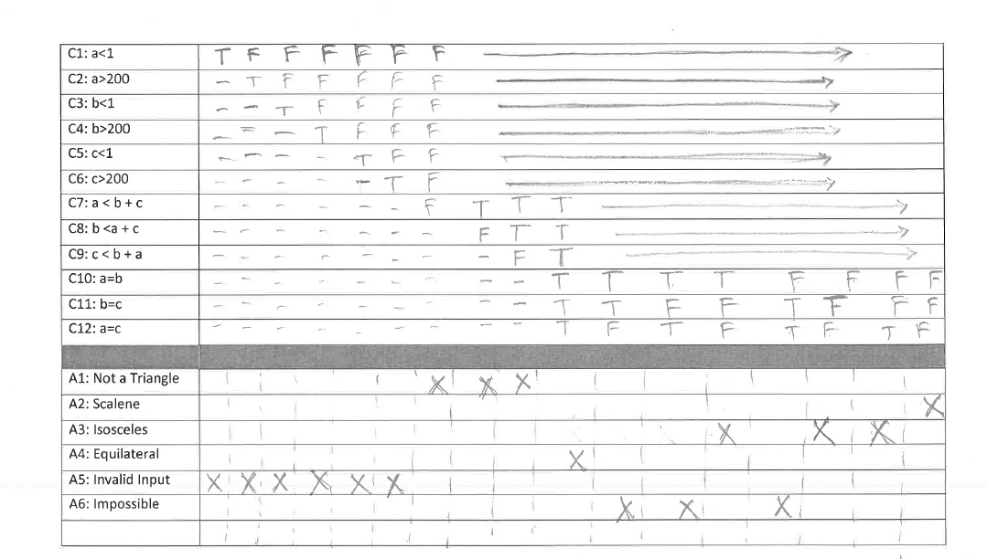
Triangle Problem – Decision Table (Length Restriction)

Slide 11
Activity– Add Decision Table Test Cases for the Triangle Problem

Slide 12
Is Leap Year (in-class activity)- Decision Table
A year is a leap year under the following conditions:
– The year is exactly divisible by 4
– Century years are leap years only if they are exactly divisible by 400
a) Develop a decision table to determine whether or not a given year is a leap year.
– Hint: you might find it convenient to have an “impossible action” to identify impossible conditional situations.
b) Use your decision table to identify test cases for a boolean function isLeap(year) that returns True when the argument is a leap year, and False otherwise.

Slide 13
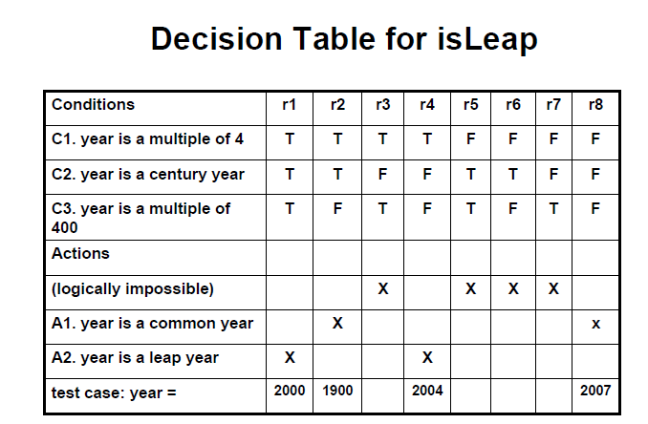

Slide 14
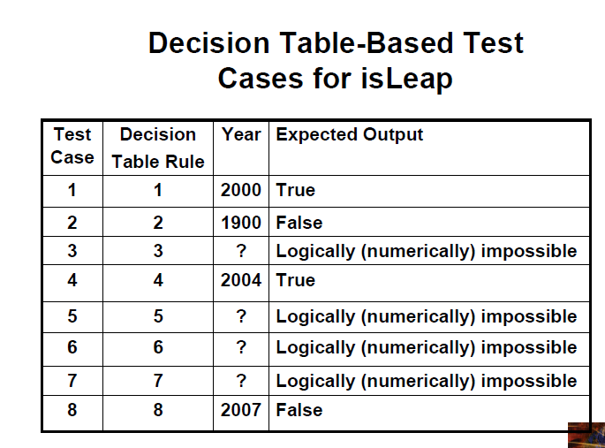

Slide 15
Next Time
Limitations of EP, DT, and DVA : A case for state based testing
Introduction to state based testing

